Slide 1
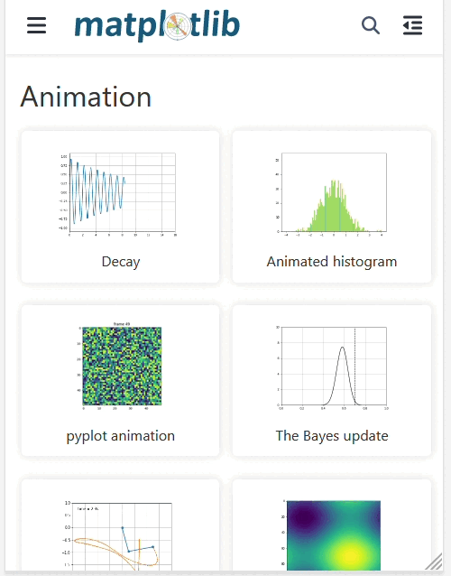
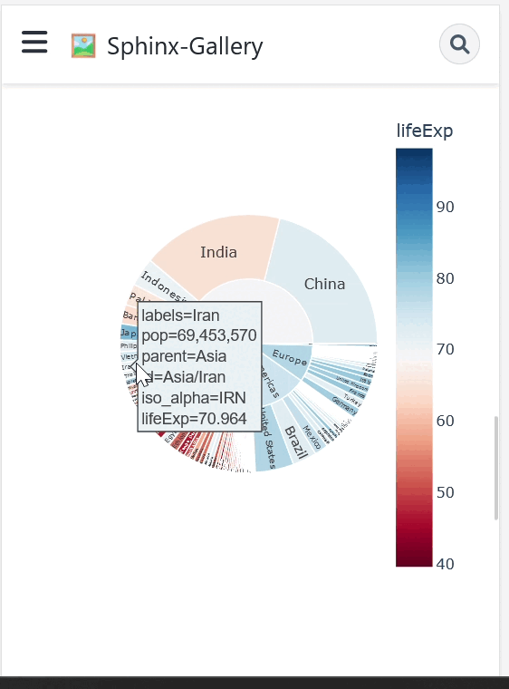
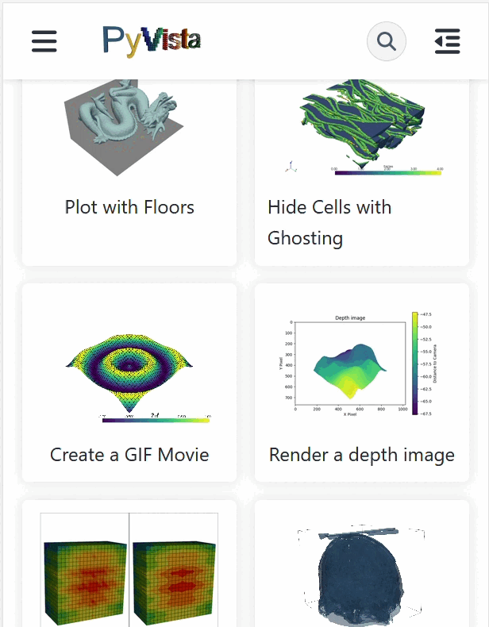
Sphinx-Gallery: Write Python, Have Gallery

Slide 2
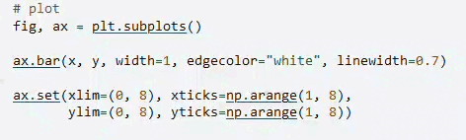
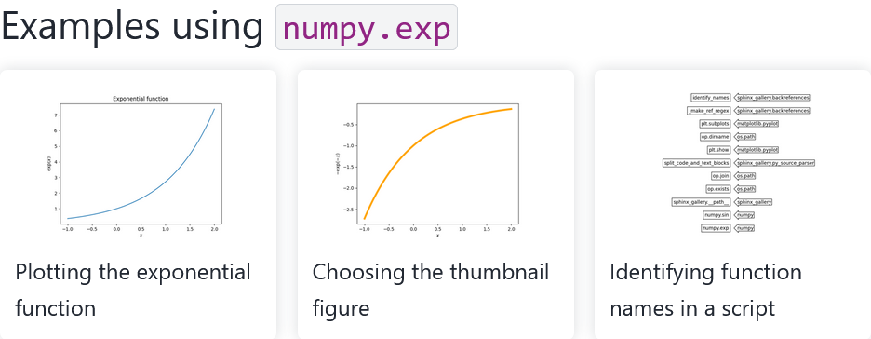
Intersphinx: connect code w/ docs
Minigalleries: add small galleries (subset) in docs

Slide 3
dev | Parallel gallery generation (jschueller, larsoner)
V0.16.0 | ALERT: Pass fully qualified name strings to classes or callables Allow list input and wildcards for subsection order (timhoffm) Minigallery can be built from arbitrary files/glob pattern (story645)
V0.15.0 | Examples recommender system (ArturoAmorQ) Text gallery entries from source files in any language (speth) Improved debugging info (larsoner) and CI/packaging (Borda) General improvements (lucyleeow) Contributing guide (lucyleeow, larsoner, story645)

Slide 4
Add sphinx gallery to your project!
you can add your own scraper to capture non-matplotlib images, e.g., napari screenshots the GUI: https://napari.org/dev/gallery/face_normals_wireframe.html
* you can capture the `_repr_html_` e.g., pandas dataframe here: https://sphinx-gallery.github.io/stable/auto_examples/plot_3_capture_repr.html
* api usage graph to show unused API entries and/or for each module, and the examples where API entries from that module were used in: https://sphinx-gallery.github.io/stable/sg_api_usage.html

Slide 5
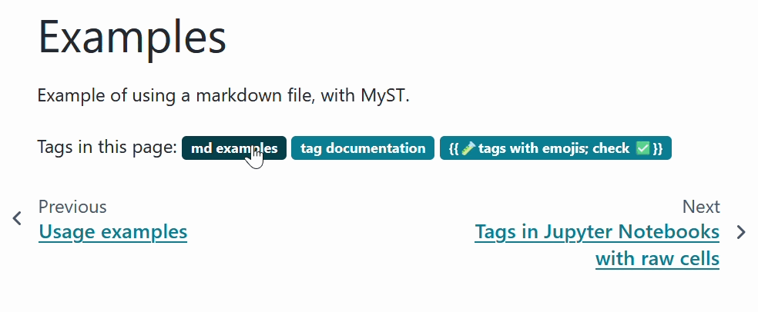
Sphinx-tags: add tags to sphinx documents!

Slide 6
What’s new(ish)
Multiline tags (@melissawm)
MyST support and tests for ref labels (@JWCook)
reference label for rst (@lucyleeow)
support for ipynb (@AlexTheLion123)
Handle special characters in tags by (@JWCook)
Add optional integration with sphinx-design badges by (@JWCook)
CI and tests (@melissawm and @JWCook)
support for sphinx-gallery and MyST(@melissawm)

Slide 7
https://sphinx-gallery.github.io
https://sphinx-tags.readthedocs.io

